Slide 1

MUSIC RECOMMENDATION SYSTEM
Presented By
Team. No: 5
Codagandla Sanjana
Suhas
Sai Krishna
Pramod
Meghana Reddy
Manjula
Yessesvini

Slide 2


Concepts:
Problem Statement
Abstract
Project Architecture
Exploratory Data Analysis
Model Building
Deployment
Conclusion

Slide 3
Problem Statement
This is a recommendation system project, that analyzes user preferences and to provide personalized recommendations. This system aims to simplify decision-making, enhance music discovery, and improve the overall user experience.
The data file contains 331616 rows × 25 columns

Slide 4
Abstract
By analyzing factors such as music genres, artists, listening history, and device compatibility, the model categorizes users into specific segments and provides targeted recommendations. Leveraging machine learning techniques, user data, and device compatibility information, the system offers personalized recommendations tailored to individual preferences and usage patterns.

Slide 5
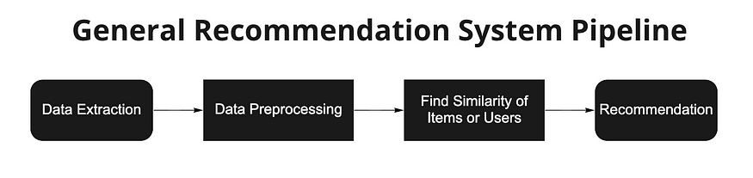
Project Architecture

Slide 6
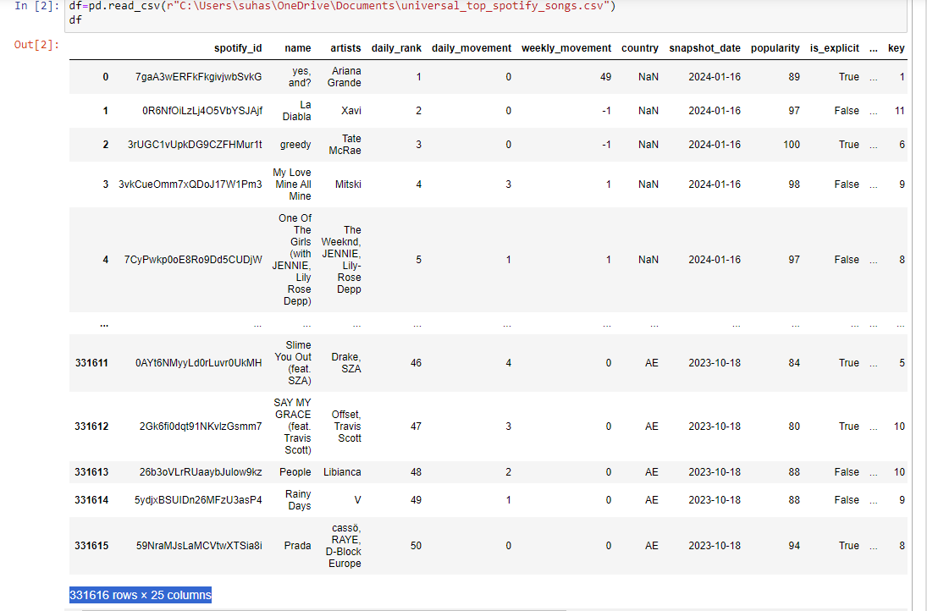
DATASET DETAILS
There are Numerical variables and as well as Categorical.
Popularity column is under focus.

Slide 7
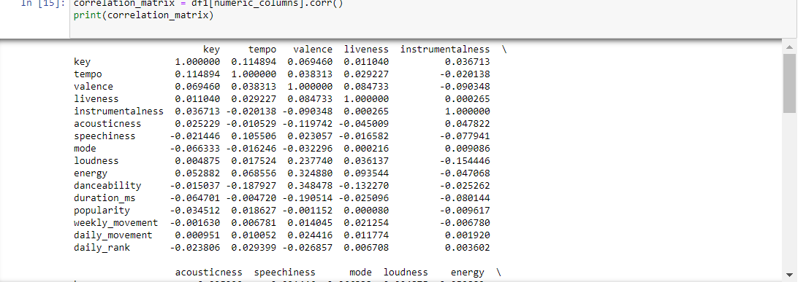

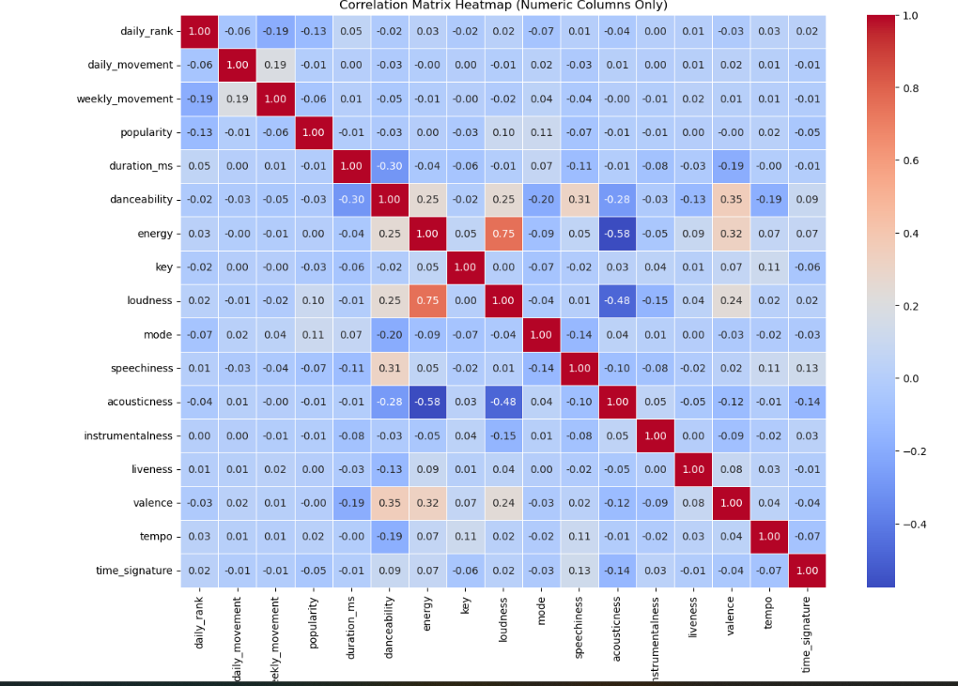
CORRELATIONS
CORRELATION AMONG THE FEATURES OF THE DATASET USING CORRELATION MATRIX
HEAT MAP

Slide 8
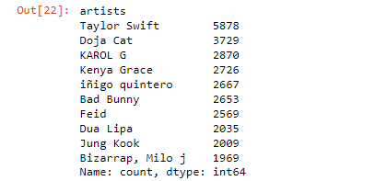
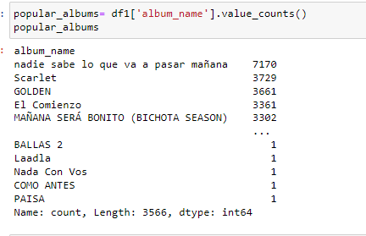
DATA PREPROCESSING 1
FILTERING THE POPULAR ARTISTS
FILTERING THE POPULAR SONGS

Slide 9
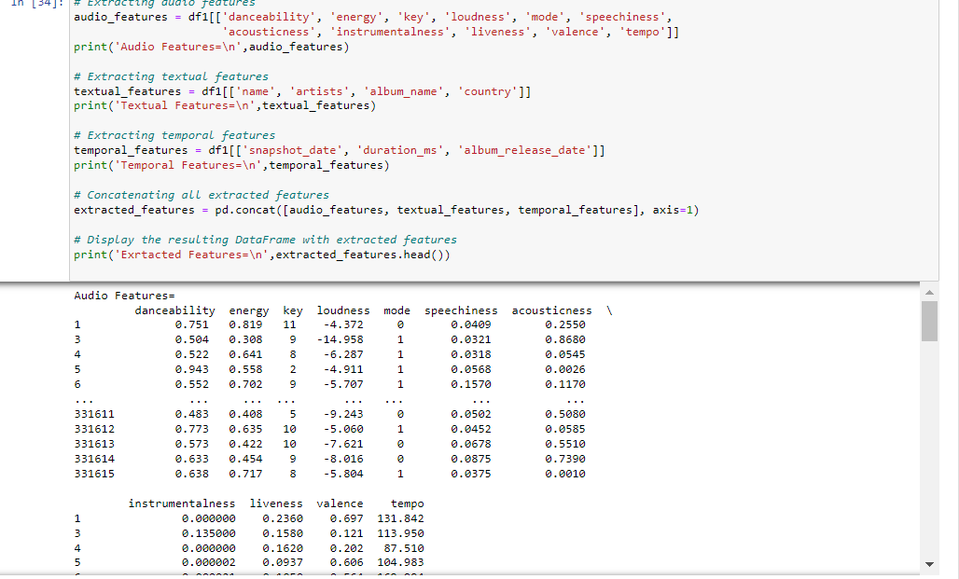
DATA PREPROCESSING 2
FEATURE EXTRACTION

Slide 10
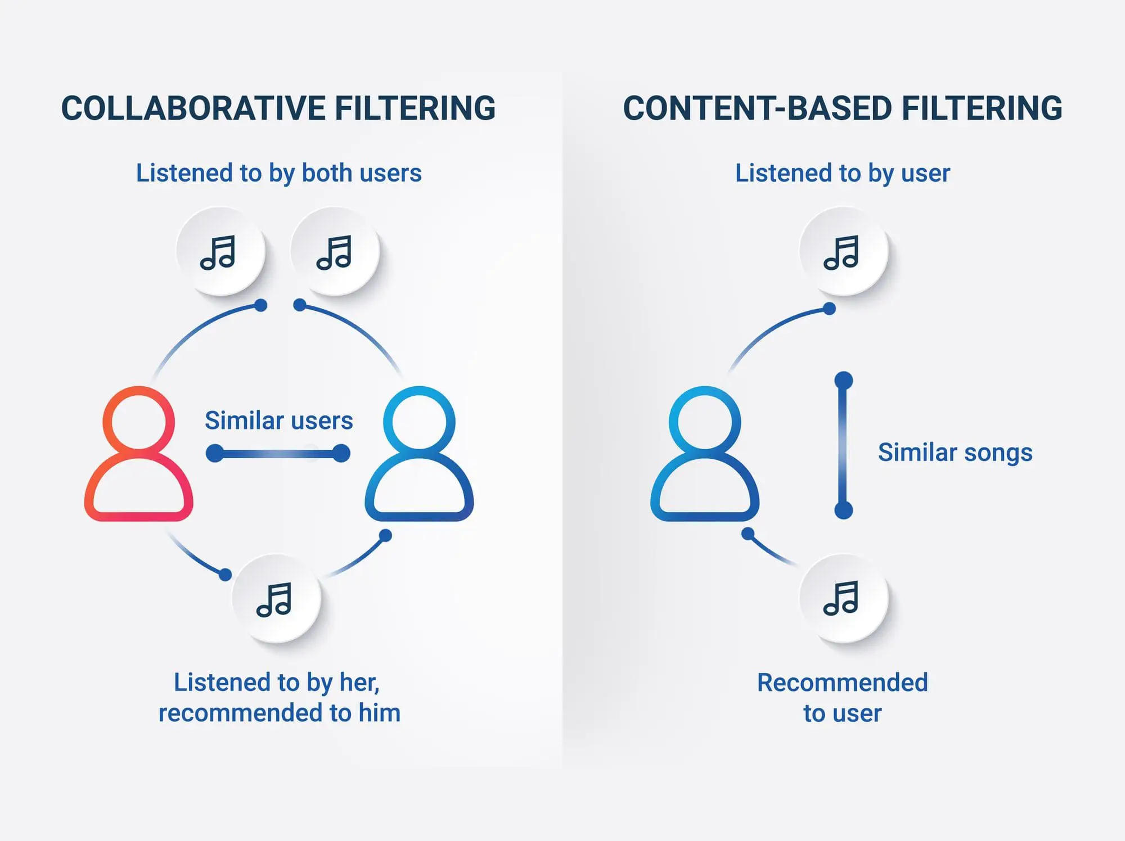
MODEL BUILDING

Slide 11
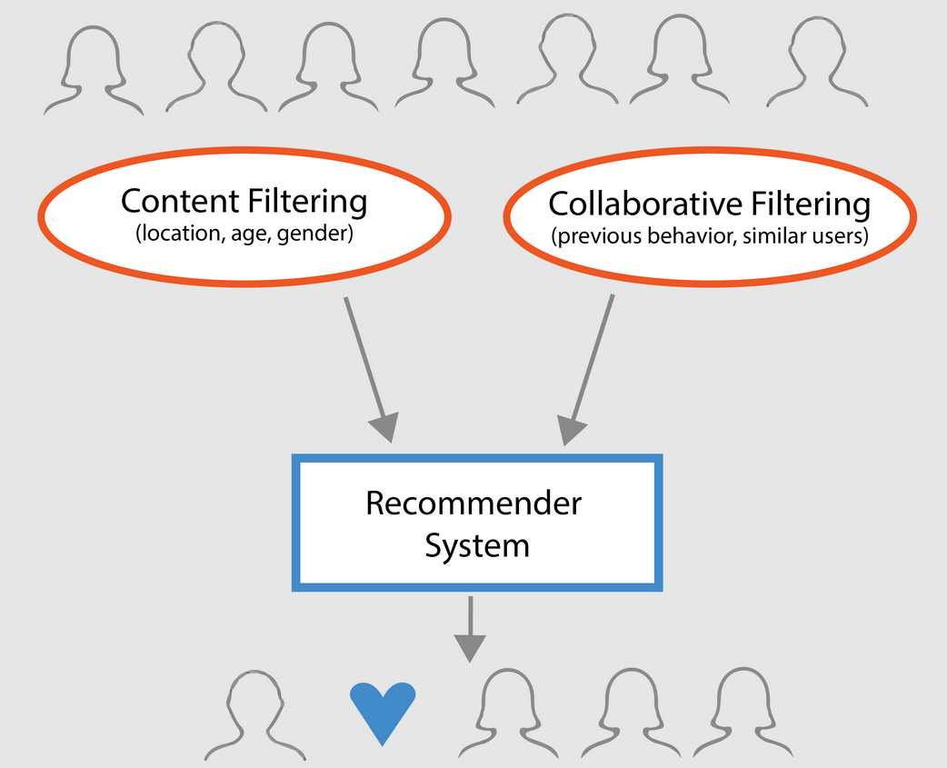
INTRODUCTION TO COLLABORATIVE FILTERING AND CONTENT – BASED FILTERING
Collaborative Filtering and Content-Based Filtering are two fundamental techniques used in recommendation systems to assist users in discovering relevant items or content tailored to their preferences.

Slide 12
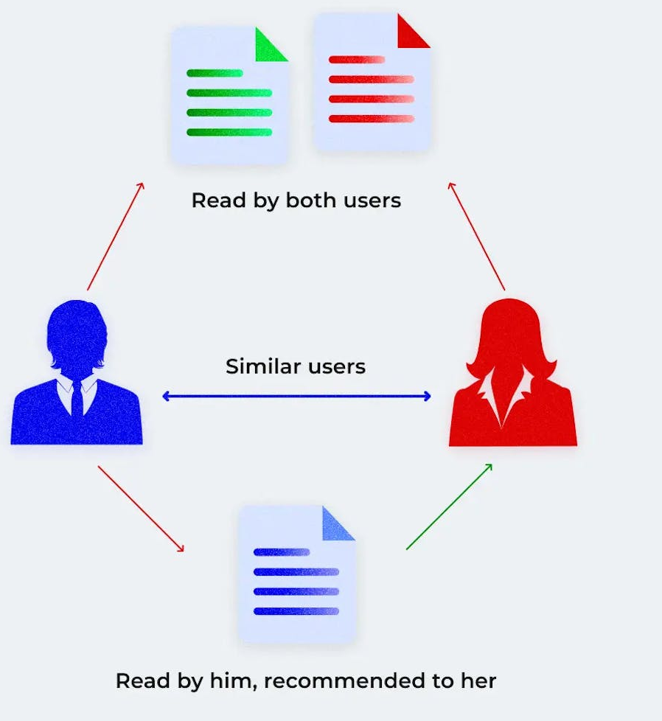
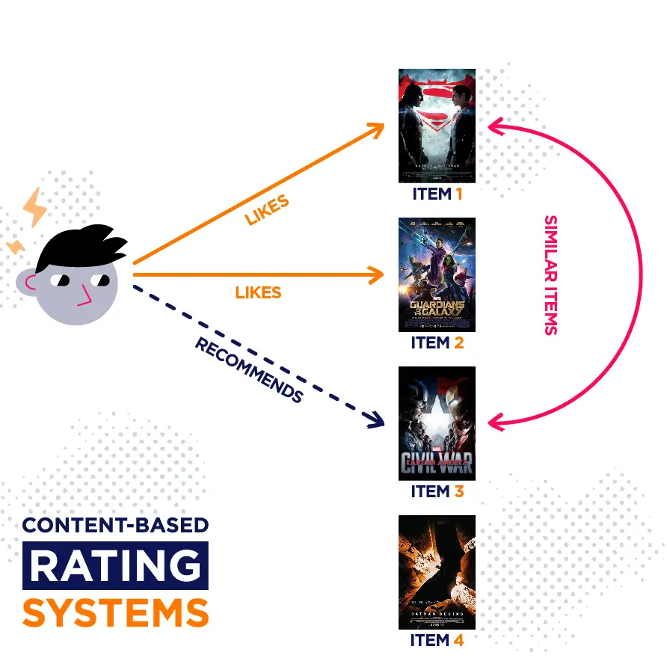
WORKING OF COLLABORATIVE FILTERING AND CONTENT – BASED FILTERING
Working of Collaborative Filtering (CF):
Similarity Calculation: CF calculates similarities between users or items based on their interaction patterns.
Neighborhood Selection: CF identifies a subset of users or items that are most similar to the target user or item.
Working of Content-Based Filtering (CBF):
Item Feature Extraction: CBF begins by extracting features or attributes from items.
Similarity Calculation: CBF calculates the similarity between items and the user profile based on the features extracted from items and the user profile. Cosine similarity or other distance metrics are commonly used for this purpose.

Slide 13
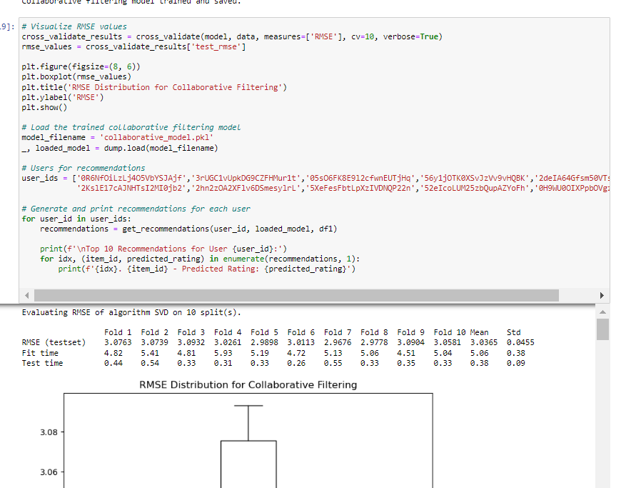
IMPLEMENTING COLLABORATIVE FILTERING

Slide 14
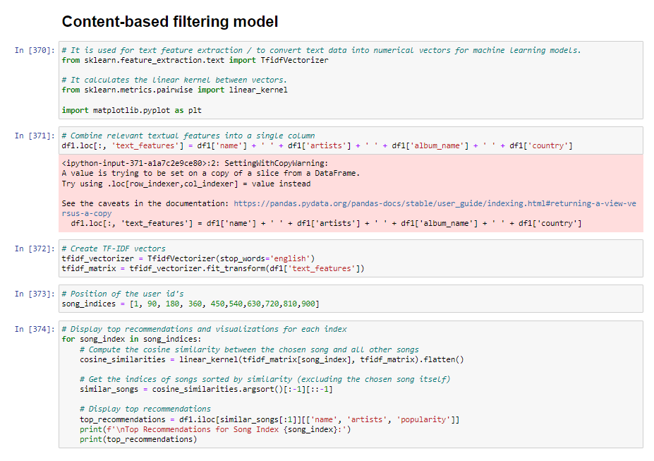
IMPLEMENTING CONTENT – BASED FILTERING

Slide 15
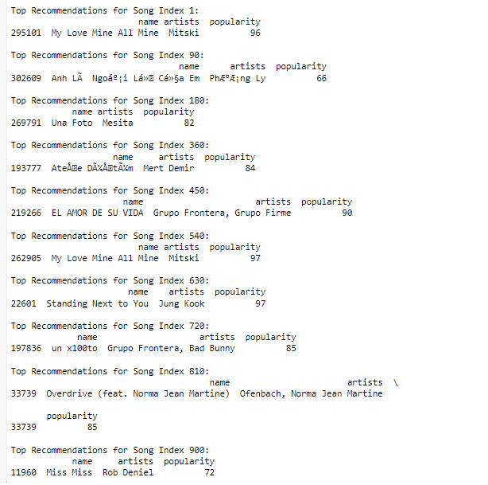
VISUALISING THE REFCOMMENDATIONS
SUGGESTED CATEGORIES

Slide 16
DEPLOYMENT

Slide 17
Challenges
Data Quality and Availability:
Insufficient and incomplete data may hinder accurate predictions.
Feature Selection:
Identifying the most relevant features from a large set of variables can be complex.
Model Deployment:
Transitioning from a successful model in a controlled environment to a real-world deployment can be challenging.

Slide 18
Conclusion
Content-Based Filtering has provided personalized recommendations by analyzing item attributes and user preferences. It created user profiles based on past interactions and recommends items with features that match the user's preferences.
Overall, CBF has been effective for recommending items based on their intrinsic characteristics for this recommendation scenario.

Slide 19
References

Slide 20


